Slide 1
Exploratory Data Analysis(EDA) & Hypothesis Testing

Slide 2
Overview
In this chapter we will be covering one of the most important process of Data science called EDA
Notes:
In the previous section we have covered all the basic fundamentals of Data and Data Science.
In this module we will be covering the details about Exploratory Data Analysis and its techniques

Slide 3
In this section we will discuss about:
What is EDA?
Common terms in EDA.
EDA and its significance
Steps in EDA
Measures of Central Tendency
Measures of Dispersion
Shape of Data
Different types of EDA
Hypothesis Testing
Notes:
In this module we are going to study about
Exploratory data Analysis
It is one of the main procedure in Data science to help look at data before making any assumptions.
It can help identify obvious errors, as well as better understand patterns within the data, detect outliers or anomalous events, find interesting relations among the variables.
The topics covered are:
What is EDA?
Common terms in EDA.
EDA and its significance
Steps in EDA
Measures of Central Tendency
Measures of Dispersion
Shape of Data
Different types of EDA

Slide 4
Learning Objectives
To maximize the insight into a data set
To identify underlying structure of a data set
To discover hidden patterns form a dataset

Slide 5
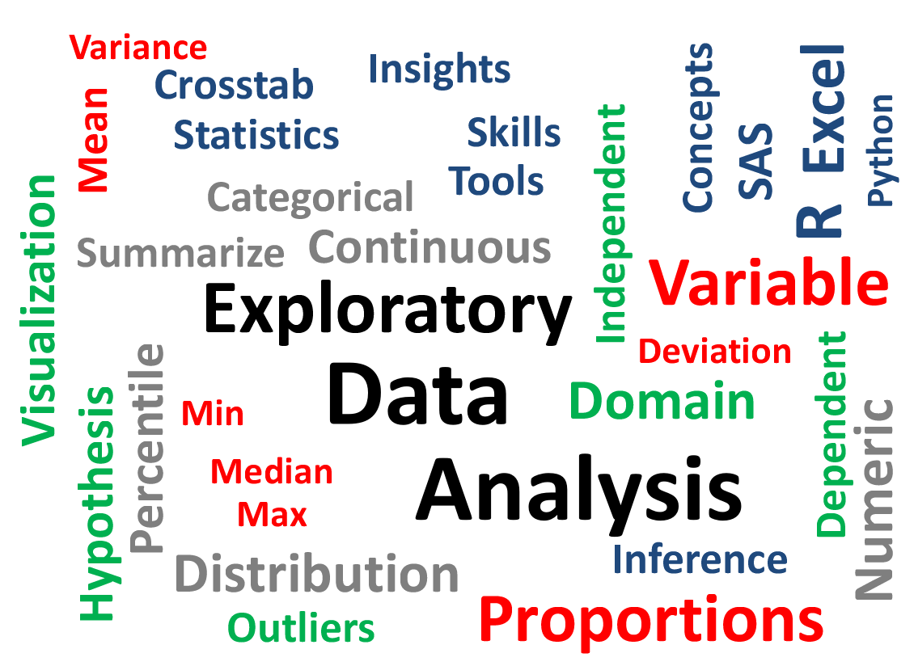
What is EDA?
Analyzing Data
Summarizing Data
Visualizing Data
https://medium.com/@srivathsagottipati/exploratory-data-analysis-eda-4b81d84ef5cf
Notes:
Exploratory Data Analysis (EDA) is a way of analyzing data and summarizing its properties, usually using visual approaches.
EDA is the starting point for every machine learning issue. It is most likely the most crucial aspect of any machine learning effort.

Slide 6
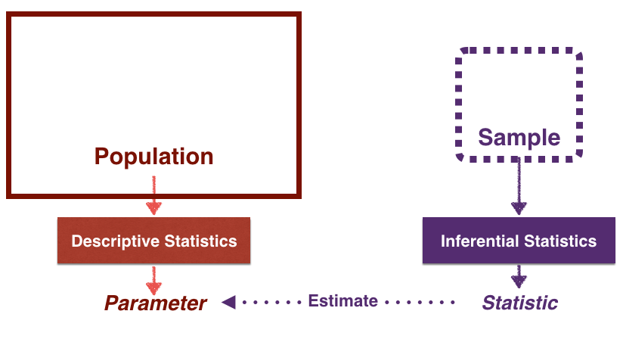
Common Terms in EDA
Common terms in EDA are:
Population
Sample
Parameter
Statistic
Variable
Notes:
This section offers a glossary of terminology that will be used often in this text.
A population is a group of units that are being investigated. People, locations, items, epochs, medications, methods, and a variety of other things can all be considered units.
A sample is a group of units drawn from a population.
A numerical value of a characteristic is called a variable.
The parameter as well as the statistic are both variables.
A numerical attribute of a population, such as its mean, is called a parameter.
A statistic is a number that may be calculated from a sample of data.
To estimate population parameters, statistics are utilized.

Slide 7
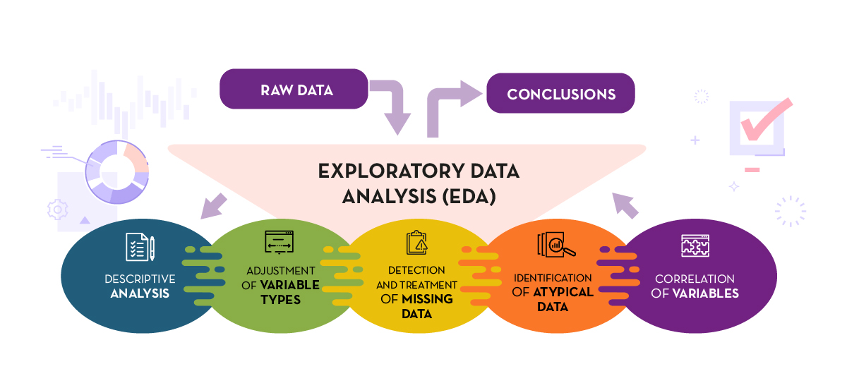
EDA and its Significance
Descriptive Analysis
Adjustment of variable types
Handle missing and noisy data
Correlation of variables
https://datos.gob.es/en/documentacion/practical-introductory-guide-exploratory-data-analysis
Notes:
Exploratory Data Analysis or EDA entails using a collection of statistical approaches to explore, describe, and summarize the nature of data in such a way that impartiality and interoperability are guaranteed.
This enables us to spot potential mistakes, detect outliers, examine the link between variables and probable redundancy, and conduct a descriptive study of the data using graphical representations and summaries of the most important parts.
The first step in doing exploratory data analysis is to take a broad look at your dataset.
Begin by calculating the size of your dataset, including the number of rows and columns. This might assist you in anticipating any data concerns that may arise in the future.
Another advantage of EDA is that it might aid in the comprehension of the variables in your dataset.
This will aid in the organization of your data and the identification of links between variables, which is an important element of data analysis.
Start looking for missing values after you've examined your dataset and we can fill it with some estimates
EDA may also aid in the identification of links between variables in your dataset.
Finding the correlations between variables is an important step in generating inferences from a dataset.
Another key stage in EDA is locating outliers in your dataset.
Outliers in your dataset are numbers that are notably different from the rest.
During your EDA, you may look for outliers by looking at your graphs or sorting your data numerically.
https://www.indeed.com/career-advice/career-development/how-to-conduct-exploratory-data-analysis

Slide 8
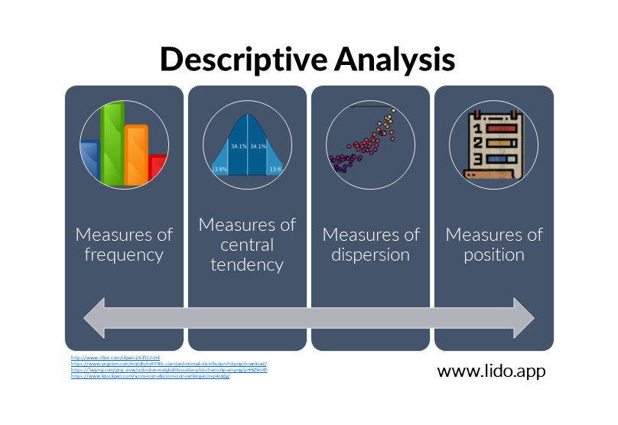
Descriptive Analysis
Measures of frequency
Measures of central tendency
Measures of dispersion
Measures of position
https://www.lido.app/post/data-analysis-101-the-types-of-analysis-you-can-conduct
Notes:
Lets have a look into the process of EDA and its procedures in detail.
The most basic sort of analysis, both in terms of aim and mathematical and statistical approaches, is descriptive analysis.
It is required since it aids in the selection of the appropriate mathematical or statistical approach to use on the dataset.
The amount of variables in your dataset is the first thing you should figure out.
A dataset might consist of a single variable or two or more variables.
You can use univariate analysis if you just have one variable.
If you have two or more variables, you may use multivariate analysis, which allows you to see how they interact.
The common operations in descriptive analysis are
Measures of frequency
Measures of central tendency
Measures of dispersion
Measures of position

Slide 9
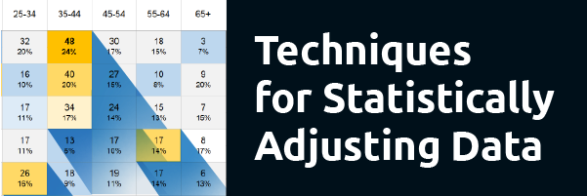
Adjustment of Variable Types
Weighting
Re-specification of variables
Scale Transformations
Notes:
Next is adjustment of variable types
To become representative of your target demographic, your data may need to be statistically corrected.
While not always essential, it might help to improve the quality of your data.
Weighting, variable respecification, and scale transformations are the three methods available to you.

Slide 10
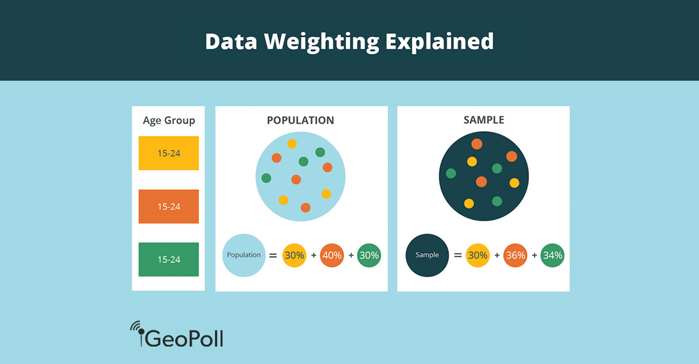
Adjustment of variable types: Weighting
Statistical adjustment process
Used to make Sample data
Representee of the target data
https://www.geopoll.com/blog/weighting-survey-data-raking-cell-weighting/
Notes:
Weighting is a statistical adjustment in which each respondent in the database is assigned a weight to represent their relative relevance to the other respondents.
The goal of weighting is to make the sample data more representative of the target population by increasing or decreasing the percentage of respondents in the sample who have particular characteristics.

Slide 11
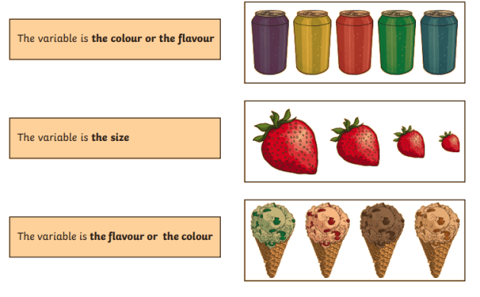
Adjustment of variable types: Re-specification of variables
Creating new variables
Modifying existing variables
Notes:
Transforming data to generate new variables or edit current variables is known as variable respecification.
The goal of variable respecification is to produce variables that are aligned with the research's goals.
Alternatively, you might construct new variables by combining several existing variables.
You may also make new variables by dividing two current variables by a ratio.

Slide 12
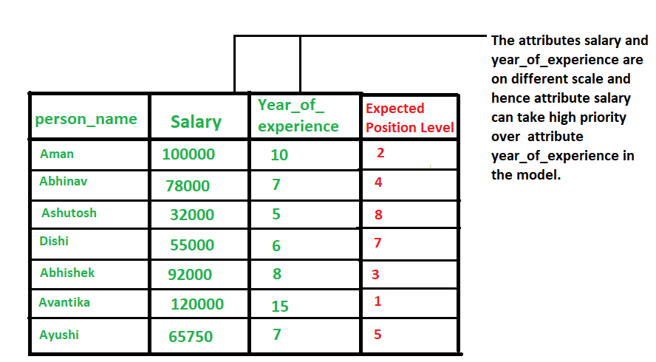
Adjustment of variable types: Transformations
1. Smoothing
2. Aggregation
3. Discretization
4. Attribute Construction
5. Generalization
6. Normalization
https://www.geeksforgeeks.org/data-normalization-in-data-mining/
Notes:
The alteration of scale values to guarantee comparability with other scales or otherwise prepare the data for analysis is known as scale transformation. Standardization, which is comparable to calculating z scores, is a frequent sort of transformation that allows you to compare variables recorded on various scales. In international marketing research, scale transformation may be necessary to guarantee that units of measurement are equivalent across nations or cultures so that relevant comparisons may be made.
Normalization and standardization are the two different techniques used for normalization technique used for data transformation
It is different from standard scaling
The data are transformed in ways that are ideal for mining the data. The data transformation consist of:
1. Smoothing
2. Aggregation
3. Discretization
4. Attribute Construction
5. Generalization
6. Normalization

Slide 13
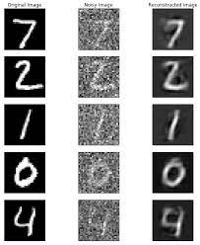
Adjustment of variable types: Smoothing
Removing noise from a dataset
Identification of key characteristics.
https://www.easy-tensorflow.com/tf-tutorials/autoencoders/noise-removal
Notes:
Smoothing is a technique for removing noise from a dataset by employing algorithms.
It enables for the identification of key characteristics in the dataset.
It aids in the prediction of trends. When gathering data, it can be altered to remove or lessen any variation or other type of noise.
be able to detect small changes and use that information to forecast various trends and patterns.
This is useful for analysts or traders who need to look at a lot of data, which might be tough to digest, in order to see patterns they wouldn't notice otherwise.

Slide 14
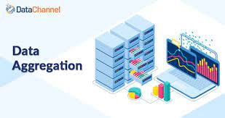
Adjustment of variable types: Aggregation
Data Collection
Storing
Presenting a summary
https://datachannel.co/blogs/data-aggregation-tools/
Notes:
Aggregation aids in the prediction of trends.
When gathering data, it can be altered to remove or lessen any variation or other type of noise.
The idea behind data smoothing is that it will be able to detect small changes and use that information to forecast various trends and patterns.
This is useful for analysts or traders who need to look at a lot of data, which might be tough to digest, in order to see patterns they wouldn't notice otherwise.
The technique of storing and presenting data in a summary style is known as data collecting or aggregation.
To incorporate various data sources into a data analysis description, the data may be gathered from numerous data sources.

Slide 15
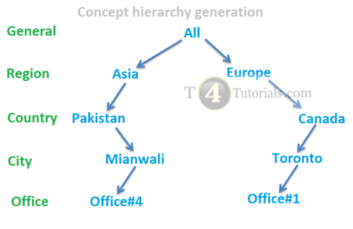
Data Discretization
Transformation of Data
Continuous data to small intervals
https://t4tutorials.com/data-discretization-in-data-mining/
Notes:
It is a process of transforming continuous data into set of small intervals.
Most Data Mining activities in the real world require continuous attributes.
Yet many of the existing data mining frameworks are unable to handle these attributes.

Slide 16
Attribute construction and generalization
Attribute Construction
Where new attributes are created & applied to assist the mining process from the given set of attributes.
This simplifies the original data & makes the mining more efficient.
Generalization: It converts low-level data attributes to high-level data attributes using concept hierarchy.
Notes:
Attribute Construction
Where new attributes are created & applied to assist the mining process from the given set of attributes.
This simplifies the original data & makes the mining more efficient.
Generalization: It converts low-level data attributes to high-level data attributes using concept hierarchy.

Slide 17
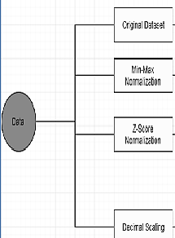
Transformation: Normalization
Decimal Scaling
Min max Normalization
Z score Normalization
https://www.geeksforgeeks.org/data-normalization-in-data-mining/
Notes:
When dealing with attributes on multiple scales, normalisation is usually essential; otherwise,
the efficacy of a significant, equally important attribute (on a smaller scale) may be diluted due to the values of other attributes on a bigger scale.
Simply said, when many characteristics exist but their values are on various scales, bad data models may result when executing data mining procedures. As a result, they are normalised in order to put all of the qualities on the same scale.

Slide 18
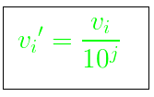
Decimal Scaling
https://www.geeksforgeeks.org/data-normalization-in-data-mining/
Notes:
It normalizes data by shifting the decimal point of the numbers.
We divide each value of the data by the largest absolute value of the data to normalise the data using this approach.
Using the formula, the data value, vi, is normalised to vi'.

Slide 19
Min Max
Where A is the attribute data, Min(A), Max(A) are the minimum and maximum absolute value of A respectively. v’ is the new value of each entry in data. v is the old value of each entry in data. new_max(A), new_min(A) is the max and min value of the range(i.e boundary value of range required) respectively.
https://www.geeksforgeeks.org/data-normalization-in-data-mining/
Notes:
The original data undergoes a linear modification in this data normalisation procedure.
The minimum and maximum values from the data are retrieved, and each value is changed using the formula .

Slide 20
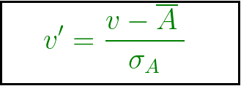
Z score Normalization
https://www.geeksforgeeks.org/data-normalization-in-data-mining/
Notes:
In this technique, values are normalized based on mean and standard deviation of the data A.v’,
v is the new and old of each entry in data respectively. σ_{A}, A is the standard deviation and mean of A respectively.

Slide 21
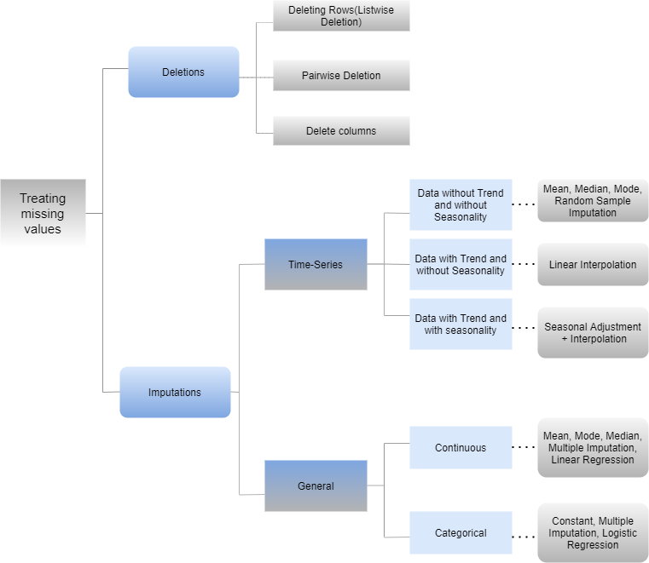
Handling Missing values
Case Deletion
Imputations
https://www.analyticsvidhya.com/blog/2021/10/guide-to-deal-with-missing-values/
Notes:
When some data in the data is missing, this condition occurs. It can be dealt with in a variety of ways.
Among them are:
Ignore the tuples: This method is only appropriate when the dataset is huge and many values are missing inside a tuple.
Fill in the blanks: There are several approaches to this problem. You have the option of manually filling the missing values, using the attribute mean, or using the most likely value.
Different techniques for case deletion and Imputations shown in the figure

Slide 22
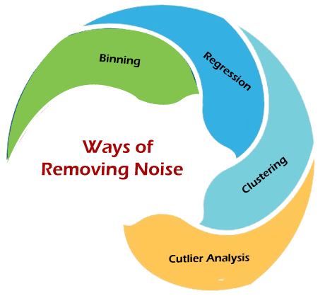
Handling Noisy Data
Binnig
Regression
Clustering
Cutlier Analysis
https://www.javatpoint.com/what-is-noise-in-data-mining
Notes:
Noisy data is data that contains a substantial quantity of extra useless information known as noise.
This involves data corruption, and the word is sometimes used interchangeably with the term corrupt data.
It also includes any data that a user system is unable to comprehend and accurately interpret.
Unstructured text, for example, is incompatible with many systems. If not managed appropriately, noisy data can degrade the outcomes of any data study and distort findings.
Statistical analysis is occasionally used to remove noise from noisy data.
Data that is damaged, distorted, or has a poor Signal-to-Noise Ratio is considered noisy. Improper processes (or procedures that are not adequately documented) for removing noise from data might lead to a misleading impression of accuracy or incorrect results.
True signal + noise = data
Techniques used to handle noisy data are Binning, Regression, Clustering and Cutler Analysis

Slide 23
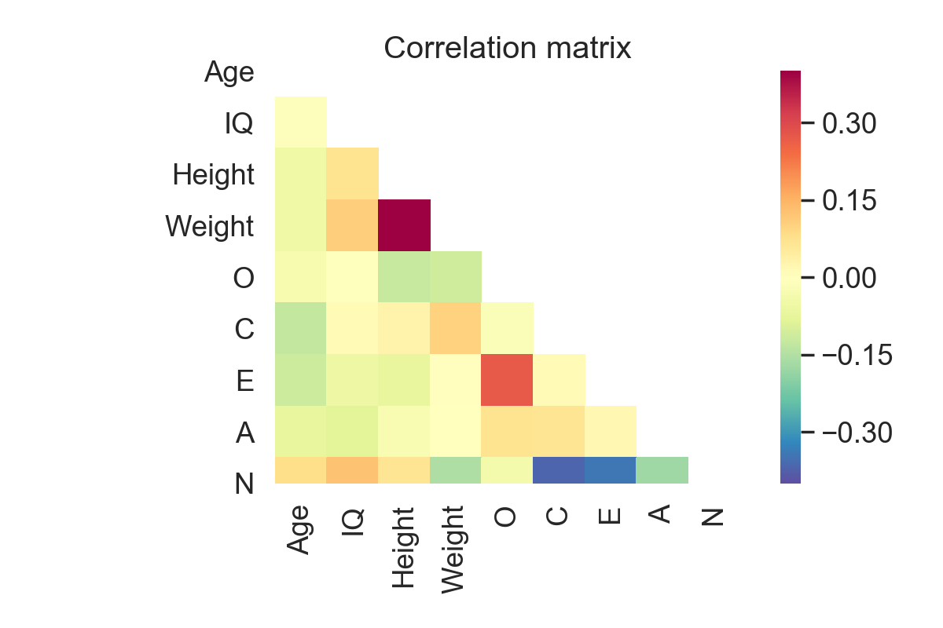
Correlation of variables
Correlation between two variables
Correlation Coefficient
https://raphaelvallat.com/correlation.html
Notes:
A correlation matrix is a table that shows the 'correlations' between two variables in a dataset.
Each number in this matrix reflects the correlation coefficient between the variables represented by the corresponding row and column, and each row and column represents a variable.
The correlation matrix is a crucial data analysis measure that is used to summarise data in order to comprehend the link between distinct factors and make informed decisions.
When dimensionality reduction on high-dimension data is necessary, it is also a critical pre-processing step in Machine Learning pipelines to compute and analyse the correlation matrix.
Each cell in the correlation matrix represents a 'correlation coefficient' between the two variables that correspond to the cell's row and column.

Slide 24
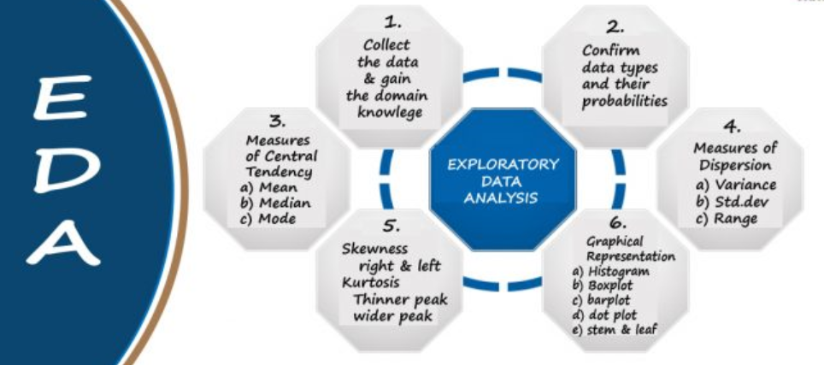
Steps in EDA
Collect Data
Confirm type of data
Descriptive Analysis
Visualization
https://blog.jovian.ai/eda-exploratory-data-analysis-on-haberman-dataset-5d19eac13526
Notes:
The first step in EDA is to collect data and gain domain knowledge.
Domain Knowledge is the underlying knowledge of the topic or environment to which data science methodologies are being applied.
The next step is to analyze about the type of data in the dataset and their significance
Each descriptive statistic condenses a large amount of information into a concise summary.
Numerical and pictorial approaches are the two most common approaches.
Statistics like the mean, median , mode , variance , range, standard deviation, skewness, kurtosis etc. are used for measuring three key aspects of a single variable such as: Dispersion, Distribution and Central Tendency
When it comes to finding patterns in data, graphical approaches such as Histogram, Box plot , dot plot. Bar plot etc. outperform numerical methods.
Numerical methods are more objective and exact.
It's a good idea to employ both the numerical and graphical techniques since they complement each other.

Slide 25

Measures of Central Tendency
Mean
Median
Mode
The mode of {4 , 2, 4, 3, 2, 2} is 2
https://statistics.laerd.com/statistical-guides/measures-central-tendency-mean-mode-median.php
Notes:
A single number that seeks to represent a collection of data by identifying the center location within that set of data is referred to as a measure of central tendency.
As a result, central tendency measurements are also known as central location measures.
They are classified as summary statistics as well.
The mean, median, and mode are all legitimate measures of central tendency, although certain measures of central tendency are more appropriate to employ than others depending on the circumstances.
The most common and well-known measure of central tendency is the mean (or average). It may be used with both discrete and continuous data, while continuous data is the most common.
The mean is calculated by dividing the total number of values in the data set by the number of values in the data set as shown in the equation.
The median is the score that falls in the center of a collection of data that has been ordered in order of magnitude.
Outliers and skewed data have less of an impact on the median.
As shown in the example the median of the given dataset is 56.
The mode is the most frequent score in our data set .
For the given example the mode is 2 since it is the most frequent item in the dataset.
https://statistics.laerd.com/statistical-guides/measures-central-tendency-mean-mode-median.php

Slide 26
Measures of Dispersion
Variance
(σ²)=∑(X−μ)²/N
Where X is the data point, μ is the mean and N is the total number of data points
Standard Deviation
S.D. = √σ , where σ is the variance
Range
2, 4,6, 7, 8 => Range = 8 -2= 6
https://byjus.com/maths/dispersion/
Notes:
The state of being distributed or spread is known as dispersion. The amount to which numerical data is expected to fluctuate around an average value is referred to as statistical dispersion.
In other words, dispersion aids in the comprehension of data distribution.
The variance is calculated by subtracting the mean from each data point in the set, then squaring and adding each square, and lastly dividing them by the total number of values in the data set as shown in the equation.
The square root of the variance is known as the standard deviation.
Range is the difference between a data set's highest and minimum values. In the given example the range is 6
https://byjus.com/maths/dispersion/

Slide 27
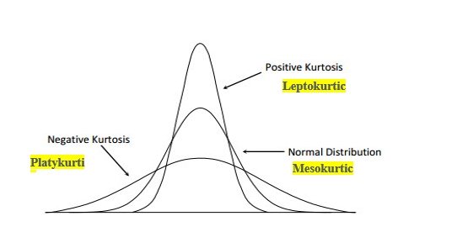
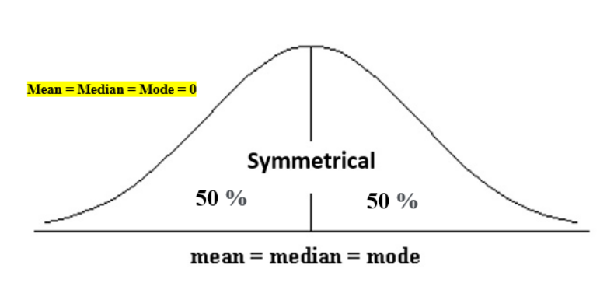
Shape of Data
Skewness
Symmetry of distribution
Kurtosis
Degree of presence of outliers
https://www.analyticsvidhya.com/blog/2021/05/shape-of-data-skewness-and-kurtosis/
Notes:
Understanding the shape of data is a critical step which is determined by the measures called s]Skewness and Kurtosis in EDA.
It aids in determining where the greatest information is hidden and analyzing outliers in a dataset.
The symmetry of the distribution is measured by skewness, whereas the heaviness of the distribution tails is determined by kurtosis.
Skewness is a measure of asymmetry in a probability distribution that differs from the symmetrical normal distribution (bell curve) in a given collection of data in statistics.
The degree of existence of outliers in a distribution is referred to as kurtosis.
Kurtosis is a statistical metric that determines whether data in a normal distribution is heavy-tailed or light-tailed.
https://www.analyticsvidhya.com/blog/2021/05/shape-of-data-skewness-and-kurtosis/

Slide 28
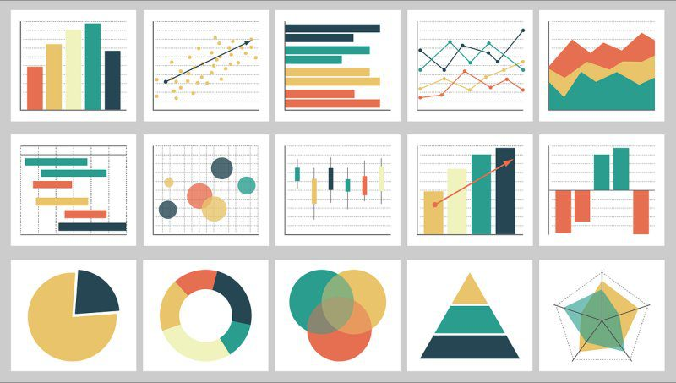
Different types of plots used in EDA for visualization
Bar chart
Scatter Plot
Line Plot
Density Plots
Pie Plot
Violin Plot
Box Plot
https://www.kdnuggets.com/2021/08/visualization-transforming-exploratory-data-analysis.html
Notes:
As we all know, the spreadsheets fall short when it comes to visual display.
EDA utilizing spreadsheet software necessitates the use of time-consuming formulae and filters.
Spreadsheets lack the speed required for analysts to swiftly find links and produce ideas, both in terms of computation and communication.
Analysts can also operate at the speed of their natural curiosity with large-scale visualization.
In most professional situations, data is used to learn rather than to generate a report.
Analysts require tools to assist them figure out what questions to ask and, depending on the responses, what questions to ask next.
This natural form of inquiry, enabled by high-performance data analytics, will not only link disparate systems together, but will also promote insight and comprehension.
The different plots shown in this section helps us to visualize the dataset graphically.

Slide 29
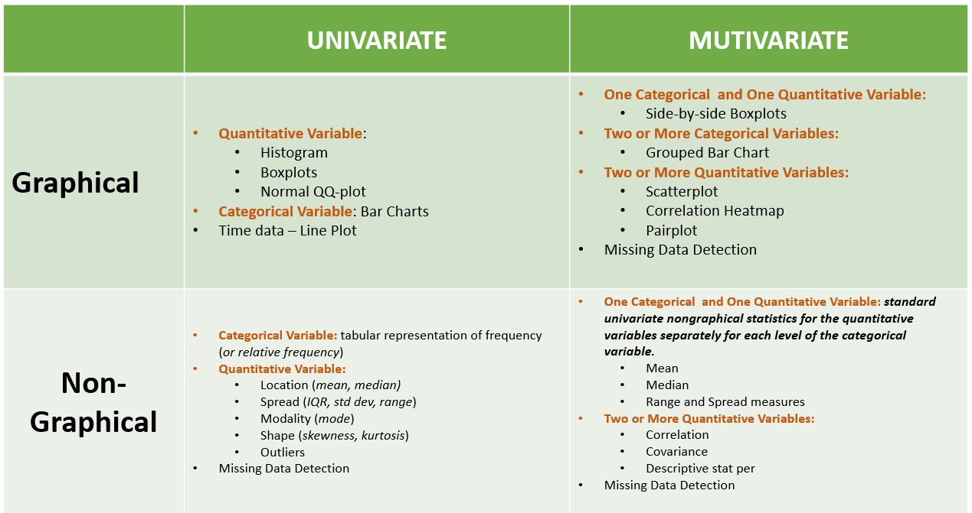
Types of EDA
Graphical
Non Graphical
Univariate
Multivariate
https://towardsdatascience.com/dramatically-improve-your-exploratory-data-analysis-eda-a2fc8c851124
Notes:
Cross-classification is common in EDA.
It can be done in a non-graphical or graphical format, and it can be univariate or multivariate.
EDA can be performed for both categorical or quantitative data using different types of representations
There are four different kinds of EDA such as Univariate non-Graphical, Univariate Graphical, Multivariate non Graphical and Multivariate Graphical
The usual goal of univariate non-graphical EDA is to
Create the “sample distribution”
Make some tentative conclusions about what population distribution(s) is/are compatible with the sample distribution.
Detect missing data
A basic tabulation of the frequency for each category is useful for categorical data like states or categories.
The best way to understand quantitative (numerical) data is to describe the centre, spread, shape, and outliers.
The mean, median, mode (central tendency), maximum, minimum, interquartile range (Q3 – Q1, higher the IQR, more spread out the data), standard deviation (spread), total count, skewness (asymmetry), and other summary statistics might be useful.
In Univariate graphical representations both categorical and quantitative data are represented using some form of graphs.
Bar charts are ideal for categorical data.
A histogram is a bar graph in which each bar reflects the frequency (count) of instances for a given set of values.
As a result, they may be used to both continuous and categorical data. They aid in the comprehension of the central trend, distribution, form, and outliers.
Cross tabulation reports and Correlation values for categorical and quantitative values are examples of Multivariate Non-Graphical techniques.
For two categorical variables (education and married status), a cross-tabulated report works well to offer an understanding of the counts or percentages.
The correlation between two quantitative variables informs us how much and in which direction one variable should change when the other changes. It's a number that ranges from -1 to +1, signifying a significant negative or positive association. Correlation is a useful measure for determining links between variables, particularly for selecting features for machine learning algorithms.
In Multivariate Graphical Technique side-by-side box plots and bar charts are useful tools for showing the relationship between a categorical and a quantitative variable.
One variable is on the x-axis and the other is on the y-axis in scatter plots, which assist for visualizing two quantitative variables in multi variate graphical technique
A point is plotted for each value in the dataset.
The scatter plot may accept more than two variables to discriminate using different sizes and shapes.
https://businessanalyst.techcanvass.com/what-are-the-exploratory-data-analysis-tools-functions-and-types

Slide 30
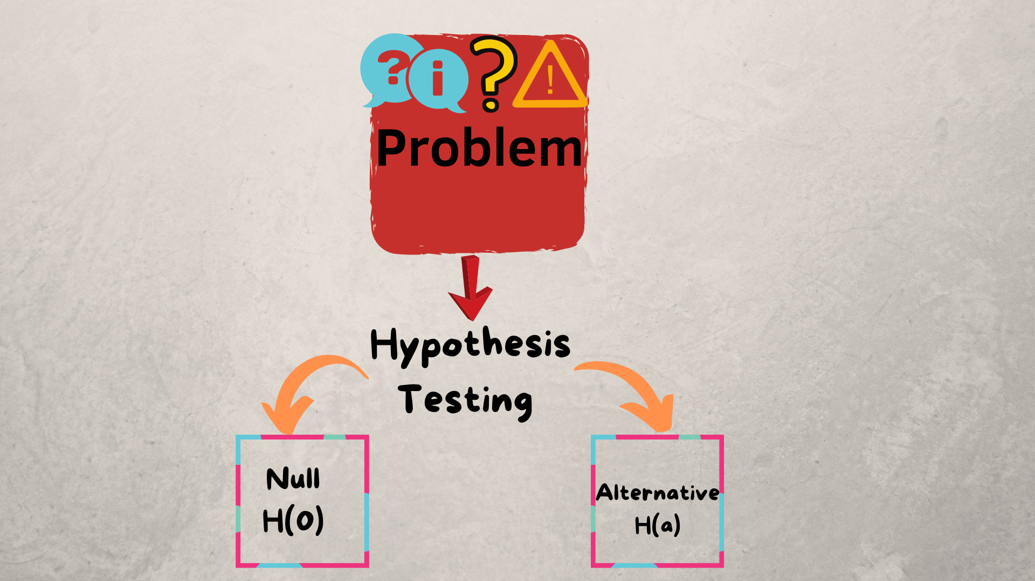
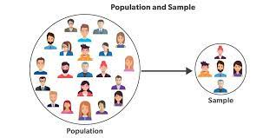
Why hypothesis testing
Using sample data, hypothesis testing is done to determine whether a claim is plausible.
The test offers proof that the hypothesis is plausible in light of the available data.
By measuring and reviewing a representative sample of the population under study, statistical analysts can evaluate a theory.

Slide 31
Steps in hypothesis testing
Define null and alternative hypothesis
Examine data, check assumptions
Calculate Test Statistic
Determine the Corresponding p-value
Make a decision about the null hypothesis.

Slide 32
Tests Considered for testing hypothesis
One-Sample T-Test
Two-Sample T-Test
Paired T-Test
Z value
The t-test is a powerful tool for investigating the differences between sample and population means.

Slide 33
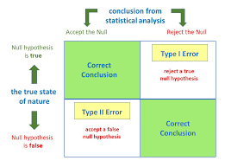
Errors in hypothesis testing
Type I Error
Type II Error

Slide 34
Statistical Power
The power of a statistical test is influenced by:
1. The significance level chosen for the test.
2. The sample size.
3. The effect size of the test.

Slide 35
THANK YOU

